Slide 1
A General Framework for Holodomor Research
Oleh Wolowyna
University of North Carolina at Chapel Hill
Annual Danyliw Research Seminar on Contemporary Ukraine
Ottawa, 8-10 November 2018

Slide 2
Status of Holodomor Research
20,000+ entries:
* mostly in Ukrainian
* few according to Western scholarly
standards
* no guiding research structures
No consensus on definitions:
* Holodomor
* Losses

Slide 3
Definitions
Holodomor:
* Famine in Soviet Ukraine
* 1932 – 1934
no Kuban
no 1921- 1923 famine
no deaths during 1935-1939
Losses (direct):
* Total actual deaths – expected deaths had
there been no famine

Slide 4
Analysis of Registered RURAL Deaths

Slide 5
Analysis of RURAL Losses

Slide 6
Framework
Module 3
AFTER
Module 2
LOSSES
DURING
Module 1
BEFORE

Slide 7
Detailed Framework
Module 3
Consequences
of the Holodomor
Module 2
Famine losses by:
geographical units
characteristics
Module 1
factors associated
with the Holodomor
causes of the Holodomor

Slide 8
Module 2 – Losses
Geography: Soviet Republics
Urban – Rural Areas
Oblasts
Raions
Characteristics: Age-sex
Nationalities
Months

Slide 9
Mathematical Relationships between Modules
Module 2 = F (Module 1):
Losses = f(economic, weather, political, controls)
Module 3 = F (Module 2):
Consequences = f(losses, other variables)

Slide 10
Uses of the Framework
Provides a structure for organizing research
Test hypothesis or accepted statements
Debunk the Russian version of the Holodomor
Powerful tool to address the two main versions about the Holodomor:
Man-made: by accident vs. on purpose
This is a MACRO framework
MICRO questions require another framework
Importance of comparative research

Slide 11
HOLODOMOR: Man-made by accident vs. Made on purpose
Man-made by accident:
* modernization – complex - affected many parts of USSR
- collectivization
- excessive grain requisition
- mismanagement
- climatic factors
Man-made on purpose:
* 1932: generalized famine – 1933: famine as weapon of terror
- resistance and repressions
- closing of borders
- massive searches and confiscation of food
- fines in kind (meat and potatoes)
- “black boards”

Slide 12
“Everybody suffered the same”
1932-34 Losses by Soviet Republics
 | Losses | Percent of
Republic | (in 1,000) | 1933 population
U.S.S.R. | 8,731.9 | 5.4
Belarus | 67.6 | 1.3
Transcaucasus | 40.1 | 0.6
Kazakhstan | 1,258.2 | 22.4
Russia | 3,264.6 | 3.2
Central Asia | 158.4 | 1.7
Ukraine | 3,917.8 | 12.9

Slide 13
“Everybody suffered the same” (cont.)

Slide 14
Higher Losses in Grain-growing Regions

Slide 15
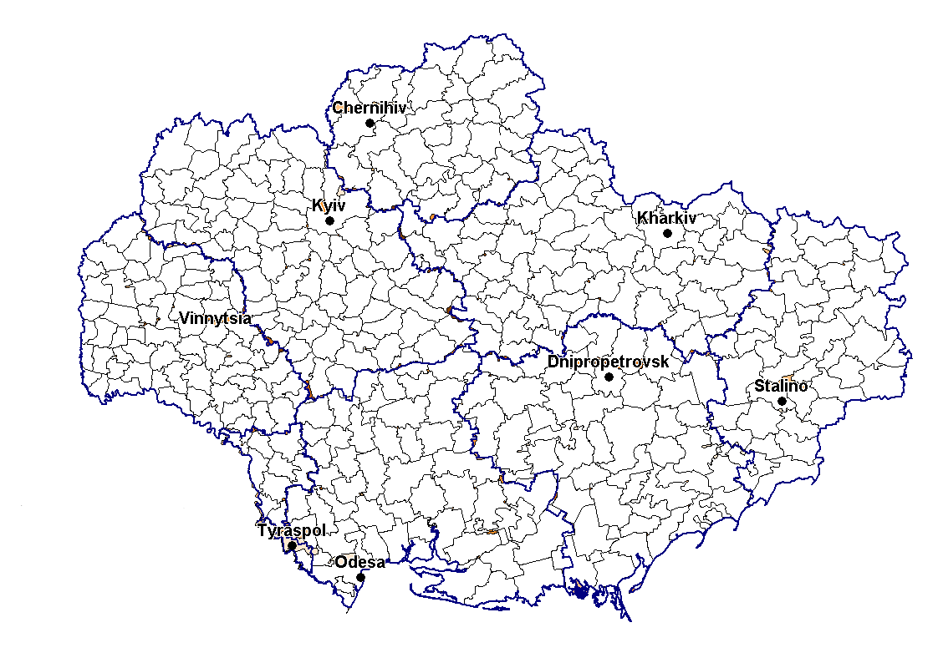
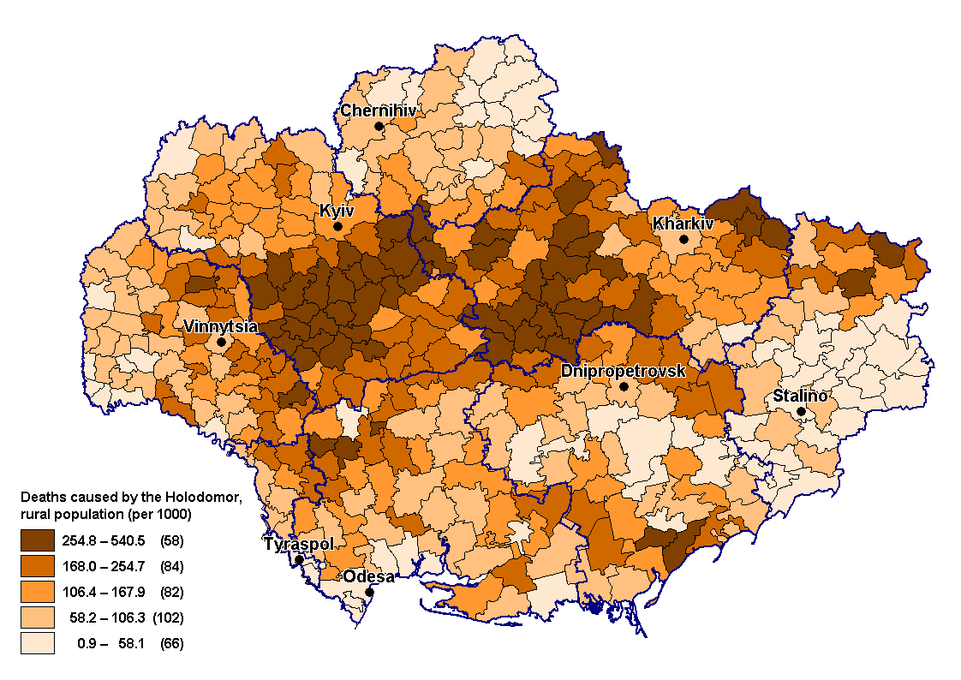
Peasant rebellions since 1918 – repressions - losses
Intensity of Peasant Rebellions during
1917- 1931
Relative 1933 Rural Losses by Raion

Slide 16
Target of Holodomor: Ukrainians or Citizens of Soviet Ukraine? Relative Rural Losses by Nationality: Ukraine, 1933

Slide 17
HOLODOMOR: by accident or on purpose?

Slide 18
HOLODOMOR: by accident or on purpose? (cont.)
*Lower Volga without Saratov and German Volga ASSR
** North Caucasus without Krasnodar
Monthly rural relative losses (per 1,000) for UkrSSR and regions of RSFSR, 1933

Slide 19
HOLODOMOR: by accident or on purpose? (cont.)
Relationship between level of 1933 monthly growth of rural losses and
different factors: UkrSSR and regions of RSFSR
Region | Level of slope of monthly losses | Resistance and repressions | Nationality factor | Closing of borders | Searches with food confiscation
UkrSSR | high | high | yes | yes | yes
Krasnodar | high | high | yes | yes | yes
Saratov | medium | limited information | no | yes | no evidence
North Caucasus* | medium | not clear | not clear | yes | unknown
Lower Volga** | low | limited information | no | yes | no
Central Volga | low | low | no | no | no
Central Black-Earth | low | low | no | no | no
* North Caucasus without Krasnodar
**Lower Volga without Saratov and Volga German ASSR

Slide 20
Module 2 Basis for Investigating Long-term Consequences of the Holodomor

Slide 21
Long-term Consequences: Diabetes Type 2
Losses
by raion
2001 census
by raion
Diabetes
registry
Losses →
Diabetes type 2

Slide 22
Demography -------→ History
Food Assistance Program: January - June, 1933
 |  | North | Lower | Central | Central
Indicators | UkrSSR | Caucasus | Volga | Volga | Black-Earth
food in tons (thousand) | 175.7 | 89.8 | 14.8 | 7.4 | 5.5
kg./person | 7.3 | 11.1 | 3.5 | 1.3 | 0.5
rural 1933 population | 24,034 | 8,080 | 4,224 | 5,871 | 10,415
relative losses* | 149 | 101 | 109 | 34 | 39
* per 1,000 population

