Slide 1
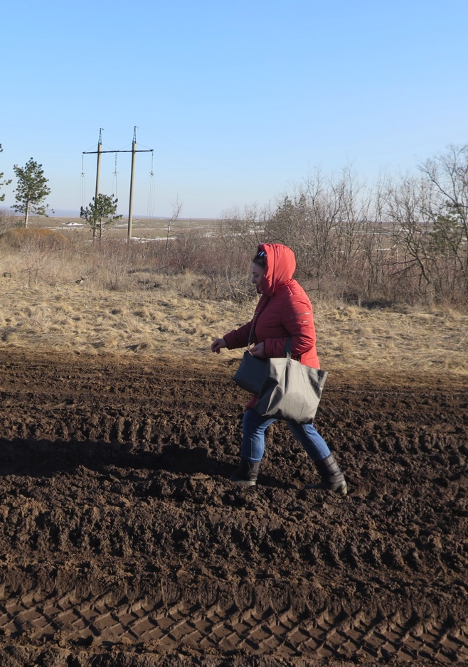
Daily Life Near the “Contact Line”: How People Experience the State in Conflict-Affected Ukraine
Tania Bulakh
Indiana University Bloomington (USA)
Department of Anthropology
Things That Matter: Humanitarian Aid and Citizenship Among IDPs in Ukraine

Slide 2
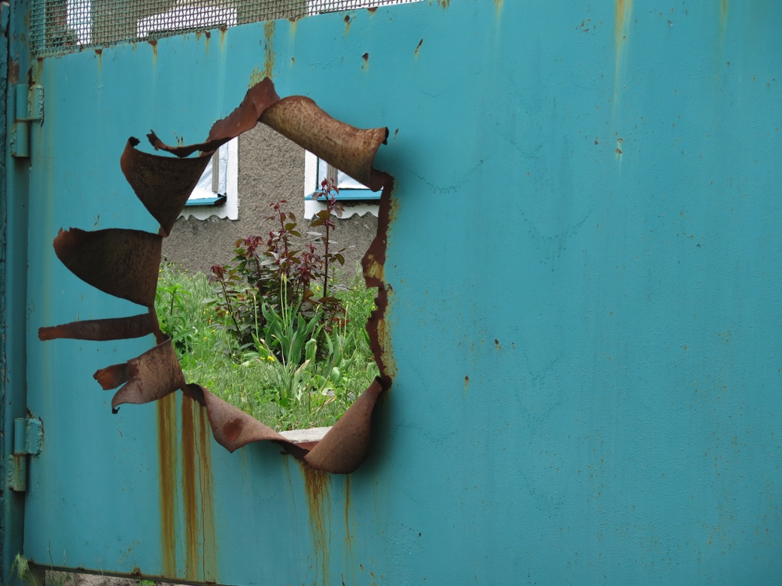
De-territorialized sovereignty Sovereignty gaps
Sovereignty gaps— areas where the state’s presence is porous, ruptured, and unstable.
“Offshore sovereignty,” Miriam Ticktin, 2009.
“Embedded borderings,” Saskia Sassen, 2013, 2017.
Granitne, Donetsk region, GCA. May 2017
Photo by the author

Slide 3
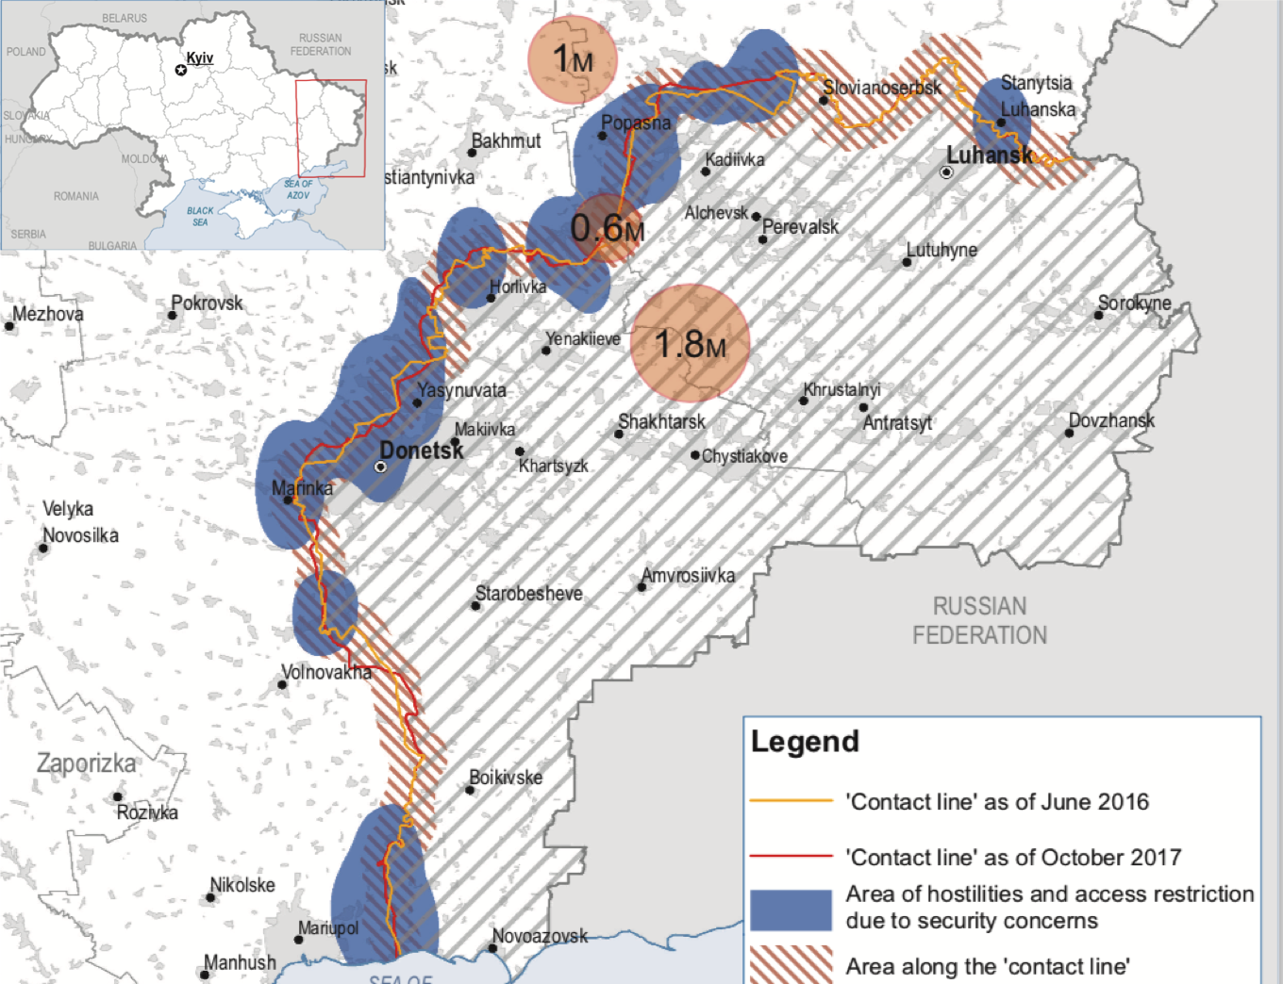
“Contact Line”
OCHA Ukraine, HNO 2017

Slide 4
Uncertainty and Normalization of Conflict
“Our people can get used to everything. It is terrible, but we got used to this conflict as well. It is always somewhere in the background. We do not even hide in the basement anymore.”
Natalia, 51 y.o.
A resident of Mariinka demonstrates a bullet that was removed from her body after she was shot by a sniper.

Slide 5
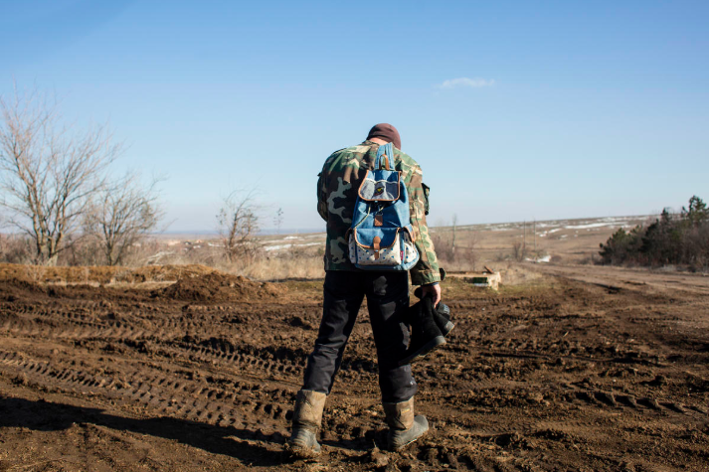
Mobility and Infrastructure
An unpaved road, which remains the only connection the village has to “the rest of the world.”
“Grey area,” Donetsk region, (c)UNHCR/Anastasiia Vlasova

Slide 6
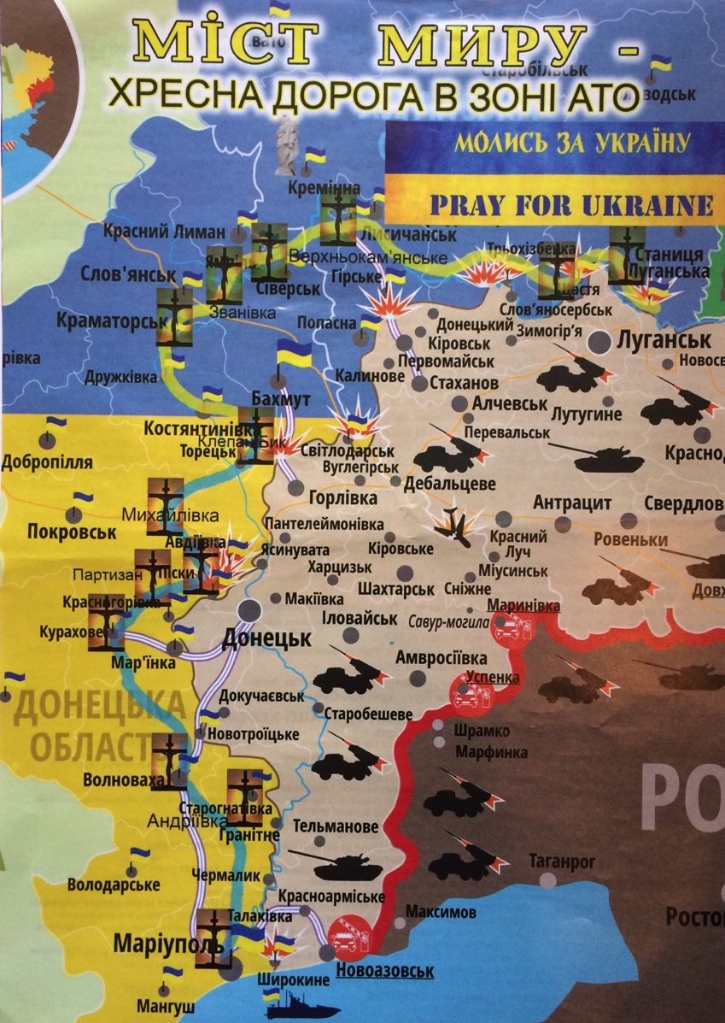
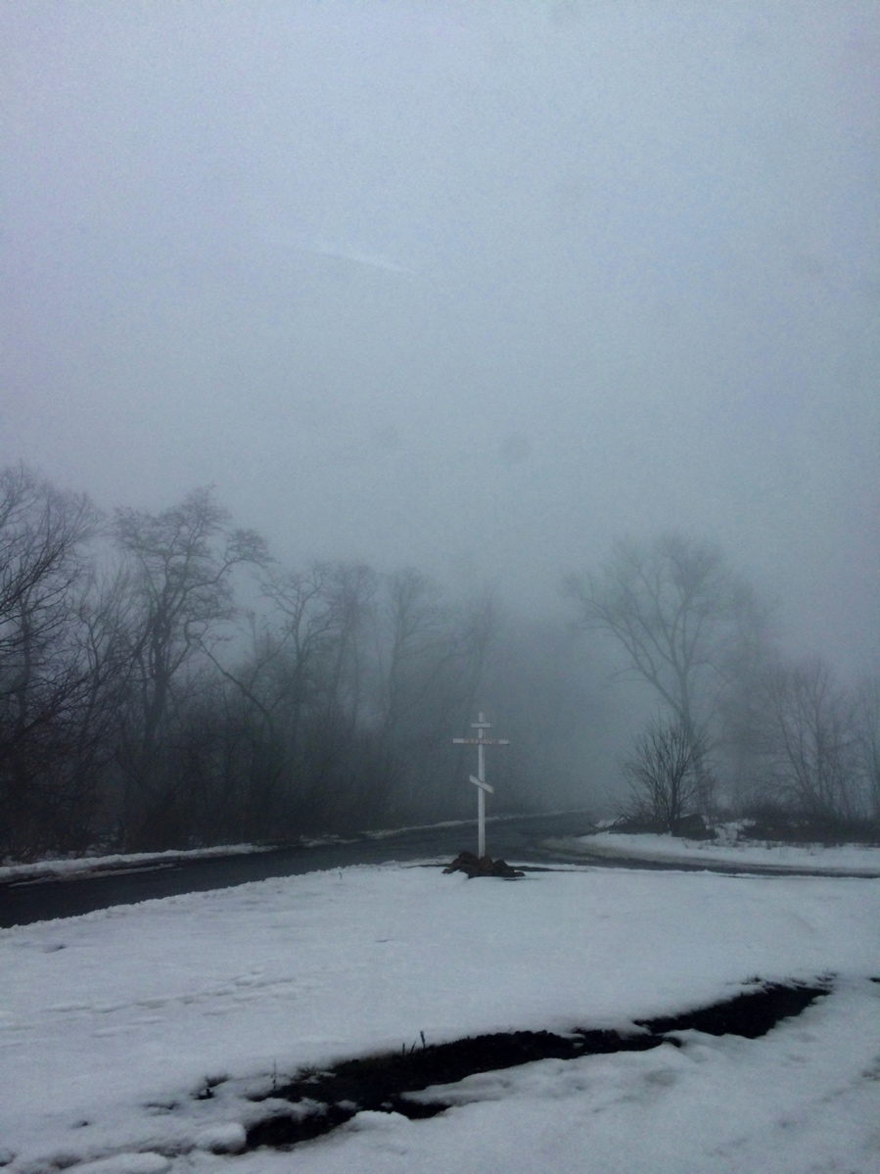
“Bridge of Hope”
“Bridge of Hope” and one of its stations near Volnovakha, March 2018

Slide 7
Thank you
tbulakh@iu.edu

