Slide 1
Failure and success of language revitalization in Ukraine
Consequences of purism
Ania Voz’naia
University of British Columbia
Danyliw Seminar 2019

Slide 2
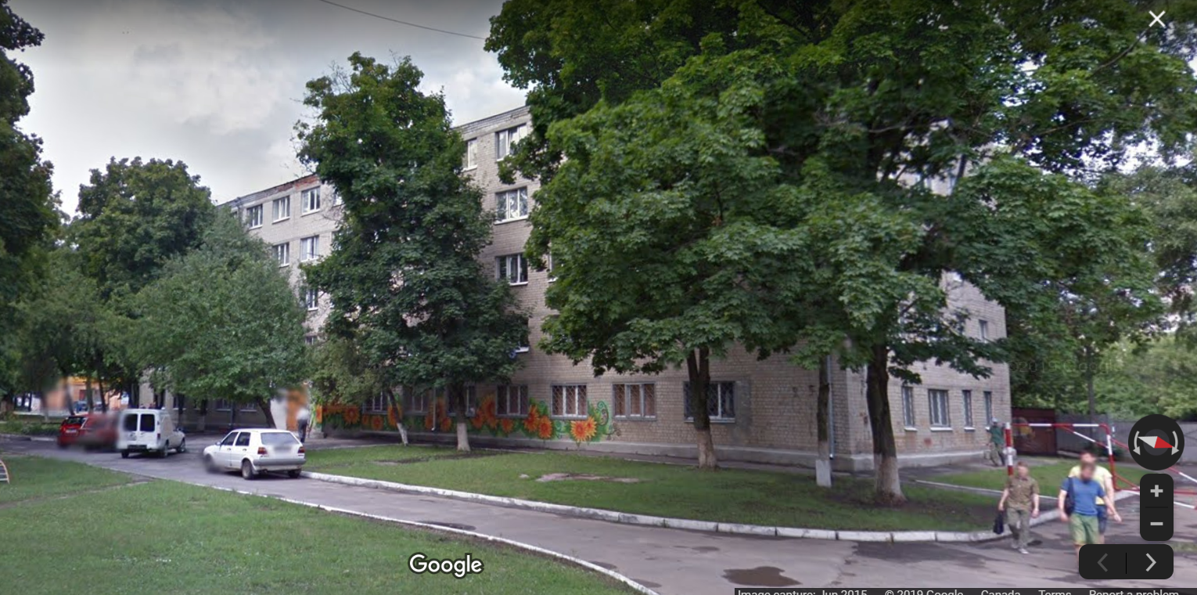
Researcher’s positionality

Slide 3
How do the ideologies of revitalization of Ukrainian frame Russian and what are the implications?

Slide 4
Biliteracy theory
Biliteracy
L1 as a resource
L2 as a resource

Slide 5
Translanguaging and development of biliteracy
Biliteracy in Context A
Literacy event A in L2
L1
L1
L2
L1
L1
L2
L2
L1
L2
L2
L1
L2
L2
L2
L1
L1
L2
L2
L1
L1
L2
L1
L1
L2
L1
L1
Translanguaging
L1
L1
L2
L1
L1
L2
L2
L1
L2
L2
L1+L2
L2
L2
L2
L1 + L2
L1 + L2
L2
L2
L1 + L2
L1 + L2
L2
L1
L1+L2
L2
L1
L1+L2

Slide 6
When L1 is not a resource
Biliteracy in Context A
Literacy event A in L2
L1
L1
L2
L1
L1
L2
L2
L1
L2
L2
L1
L2
L2
L2
L1
L1
L2
L2
L1
L1
L2
L1
L1
L2
L1
L1
L1
L1
L2
L2
L1
L1
L2
L2
L2
L1
L2
L2
L1
L2
L2
L2
L1
L1
L2
L2
L1
L1
L2
L1
L1
L2
L1
L1

Slide 7
Ideology of Revitalization of Ukrainian
Russian is a problem

Slide 8
Ukrainian language education
Russian is a problem
Translanguaging is a problem

Slide 9
Implications for motivation to use Ukrainian
Negative

Slide 10
Conclusion
If
Russian = problem
Translanguaging = problem
Then
Russian speakers do not use Ukrainian

Slide 11
Thank you for your attention

